Slide 1
Cutting Through The Noise
US centric study on music streaming in the early 2020’s

Slide 2
Content
Question and Hypothesis
Approach and Analysis
Challenges
Q1) Listeners preferred music genres.
Q2) Does Tempo of a song have an effect on popularity.
Q3) Danceability and its’ effect on Listener Popularity.
Q4) How does valence play a part in energy.
Findings and Hypothesis
Conclusion

Slide 3
Question and Hypothesis
As a musical artist in the modern age, does the type of music you make have an effect on how popular it would be with the public?
I believe the type of music does impact how widely accepted a song could be with audiences.
Does danceability in musical tracks impact popularity with listeners?
Danceability does play a large role in popularity, due to how likely it is to make a person feel positive emotions or want to play it in public places such as night clubs or events.
With pop and hip-hop being the most dominant musical genre on the radio, do other genres have a chance of breaking the mainstream?
Other genres of music do have a good chance of breaking into the mainstream regardless of genre.
Does music theory play a role in listener popularity?
Music theory such as modes and keys have a great role in popularity with an audience due to the moods and emotional perception associated with Major or Minor keys.

Slide 4
Approach
Data table downloaded from Spotify’s API as a primary source.
Formatted and cleaned using Python and Pandas for easier analysis.
SQL Queries will be utilized to obtain the data we want in a table.
Graphical visualizations will be made to showcase the findings and make it digestible to the average person.

Slide 5
Challenges
A lot of the data has some missing information so that will be discarded for our analysis.
With songs spanning multiple genres, there are multiple entries for each genre so some information will be discarded to not have so many duplicates in the visualization data.

Slide 6
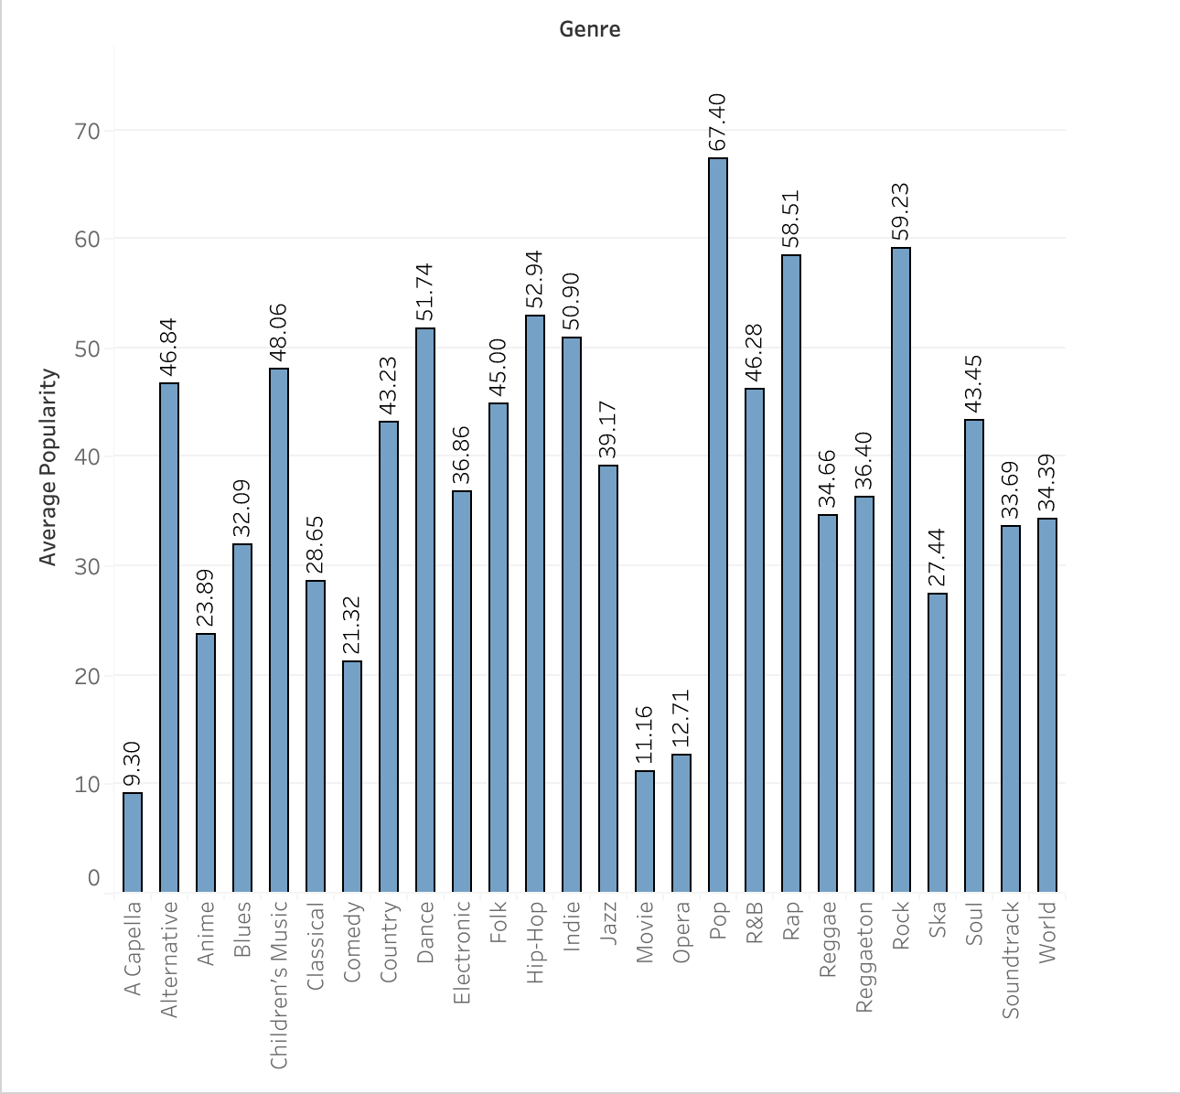
Q1) Listeners Preferred Music Genres
When analysing the data from the dataset, we can see that the most popular music genres present are Pop, Rock, and Rap.

Slide 7
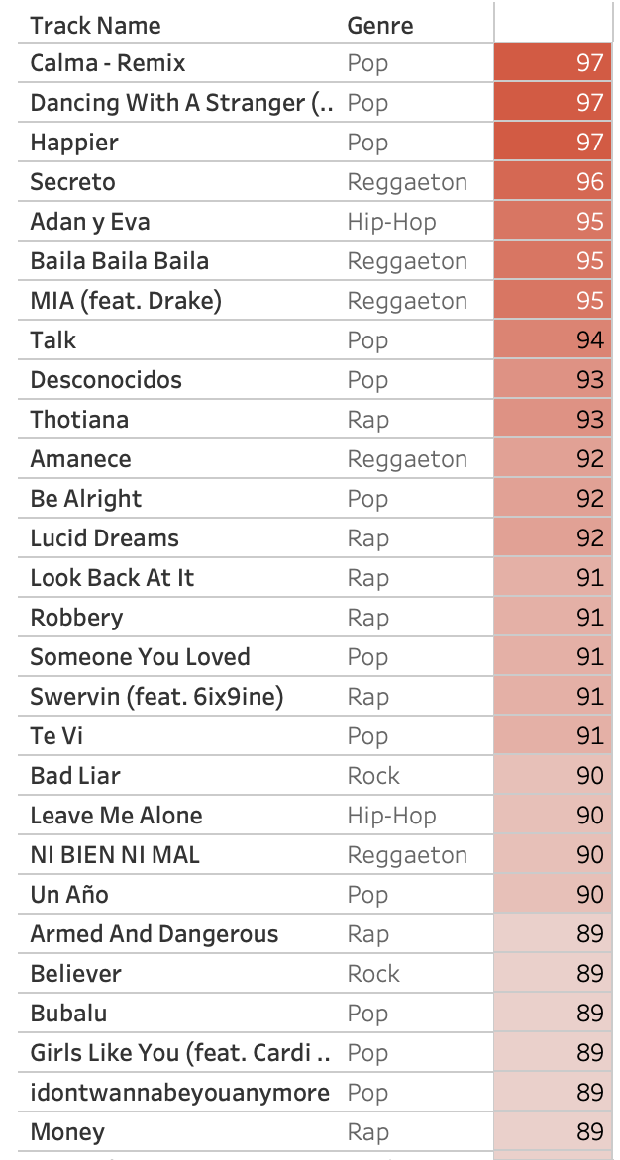
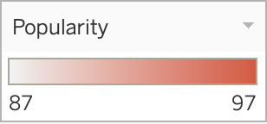
Q1 cont.
Within the top tracks, ranked on popularity, the most common genres seen are Pop, Rap, and Reggaeton, which wasn’t present in the most popular in the last visualization. This could be due to the genre seeing a surge in popularity in current times.

Slide 8
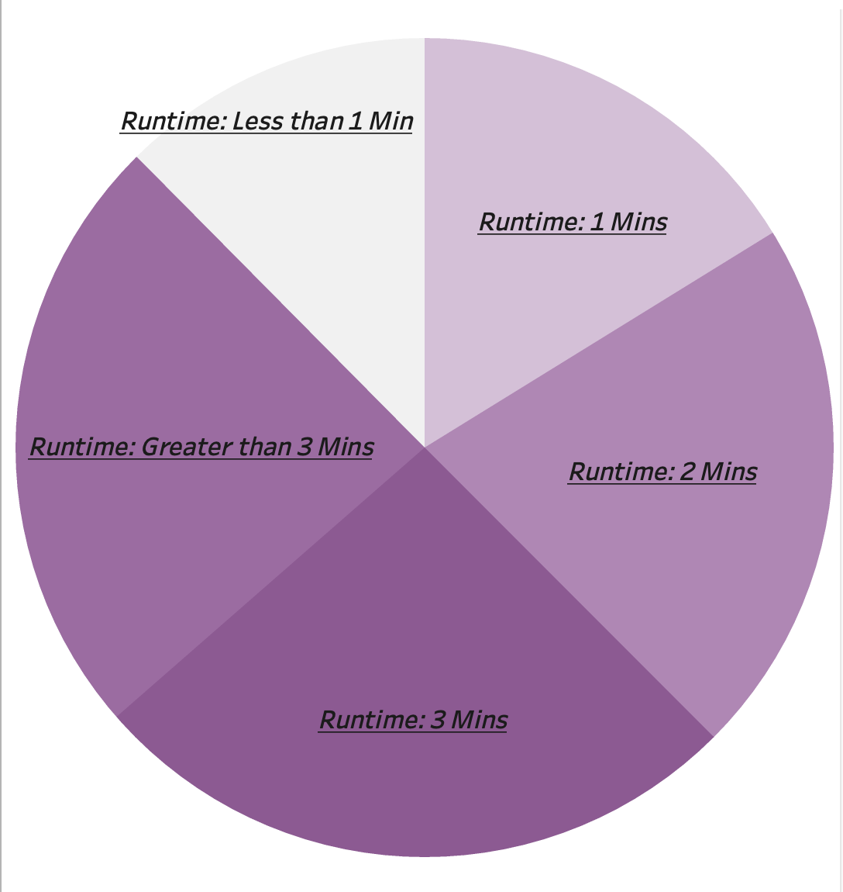
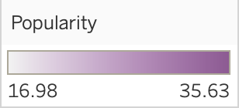
Q1 cont.
Another clue into listeners and their preferred genres, based on the graphs, we can also see that the runtime of a song plays a role in popularity. A 3 minute runtime is most popular with audiences. Pop music is notorious for using common formulas such as songwriting structures that seem to fall in a 3 minute runtime to capitalize on a listener’s attention span.

Slide 9
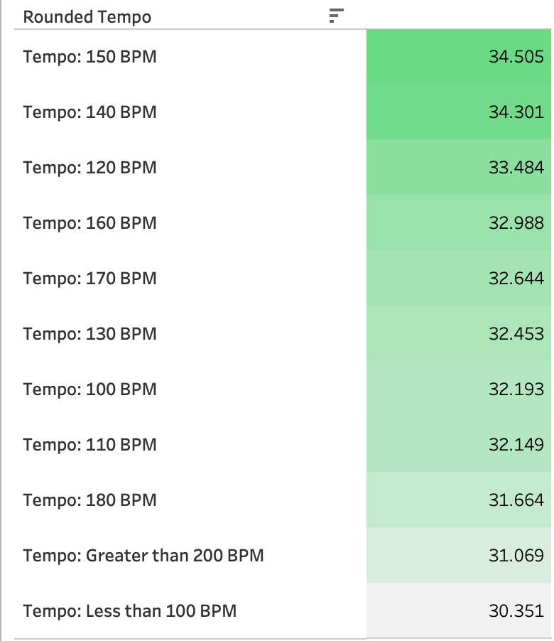
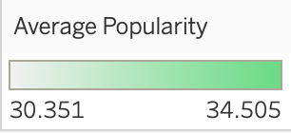
Q2) Does Tempo have an effect on Popularity?
When analysing the tempo of the dataset, songs with a tempo of 140-150 beats per minute seem to have greater popularity with listeners. These kinds of tempos are most seen in mid to fast paced pop and hip-hop songs.

Slide 10
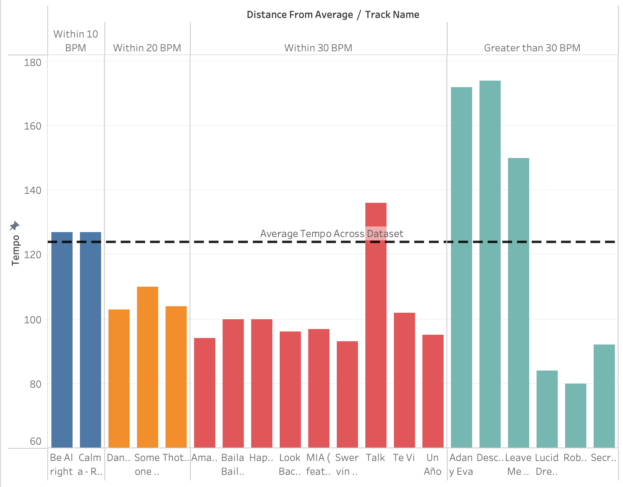
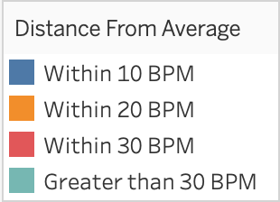
Q2 cont.
Looking at the top 20 tracks on the dataset, based on popularity, we can see that most of the tracks lie within at least 30 bpm of the average bpm across the dataset. This shows that tempo could also have something to do with how favorable a song is with listeners.

Slide 11
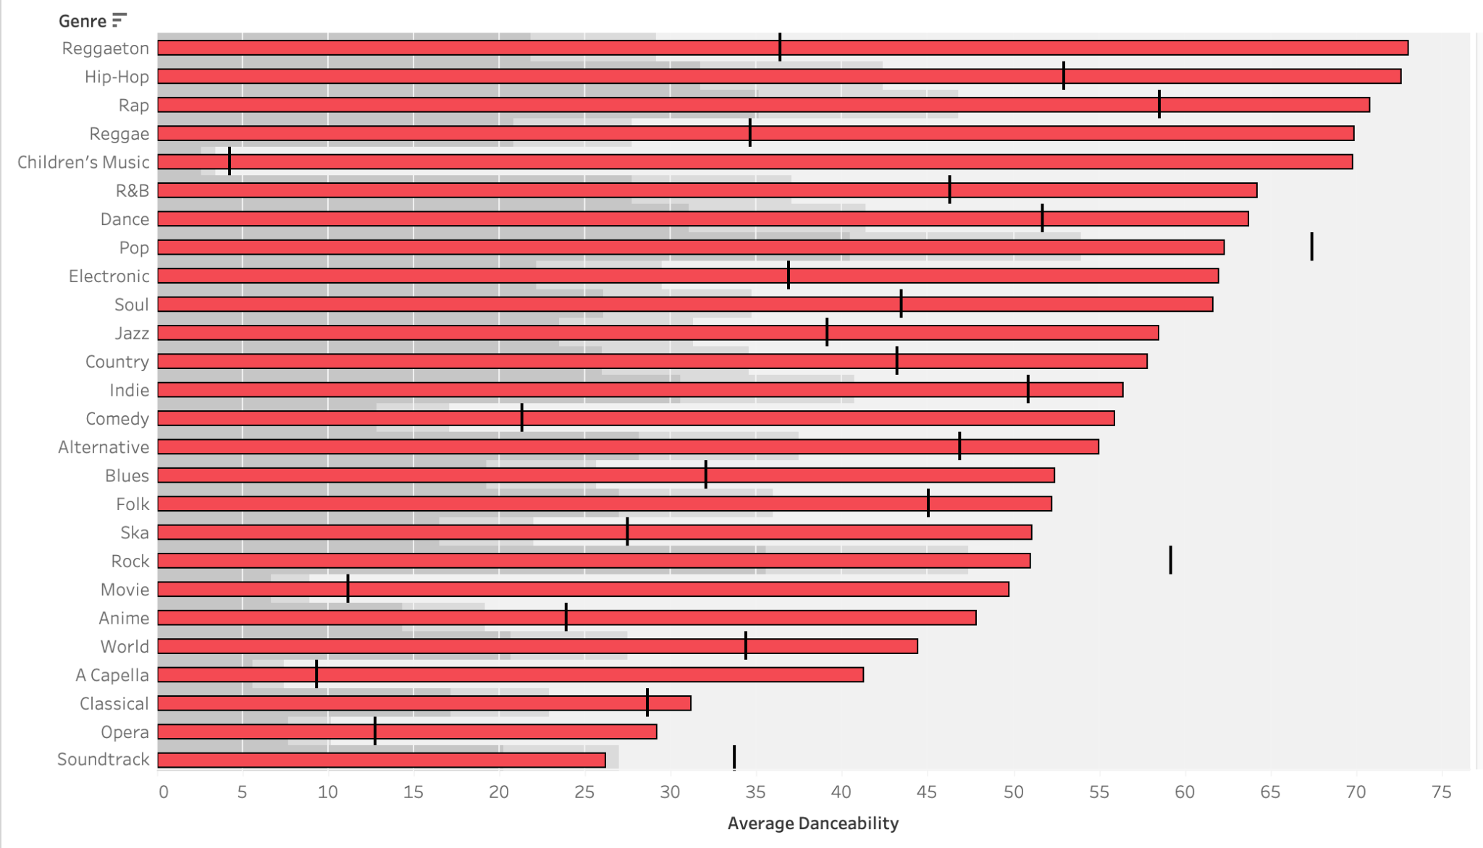
3) Danceability and Listener Popularity
The relationship between danceability and popularity doesn’t seem to be as strong but there is a trend that the danceability aspect is assumed for genres such as hip-hop and reggaeton.

Slide 12

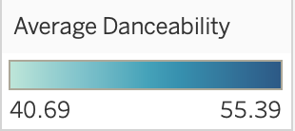
Q3 cont.
Even though danceability and popularity don’t share a truly linear relationship, the time signature of a song does play a significant role in danceability and popularity. A 4/4 time signature gives the listener a consistent beat to follow and find rhythm in, making the listener more likely to dance or hum along to a song. Other time signatures may be too confusing for the average listener to follow or find a consistent rhythm in.

Slide 13
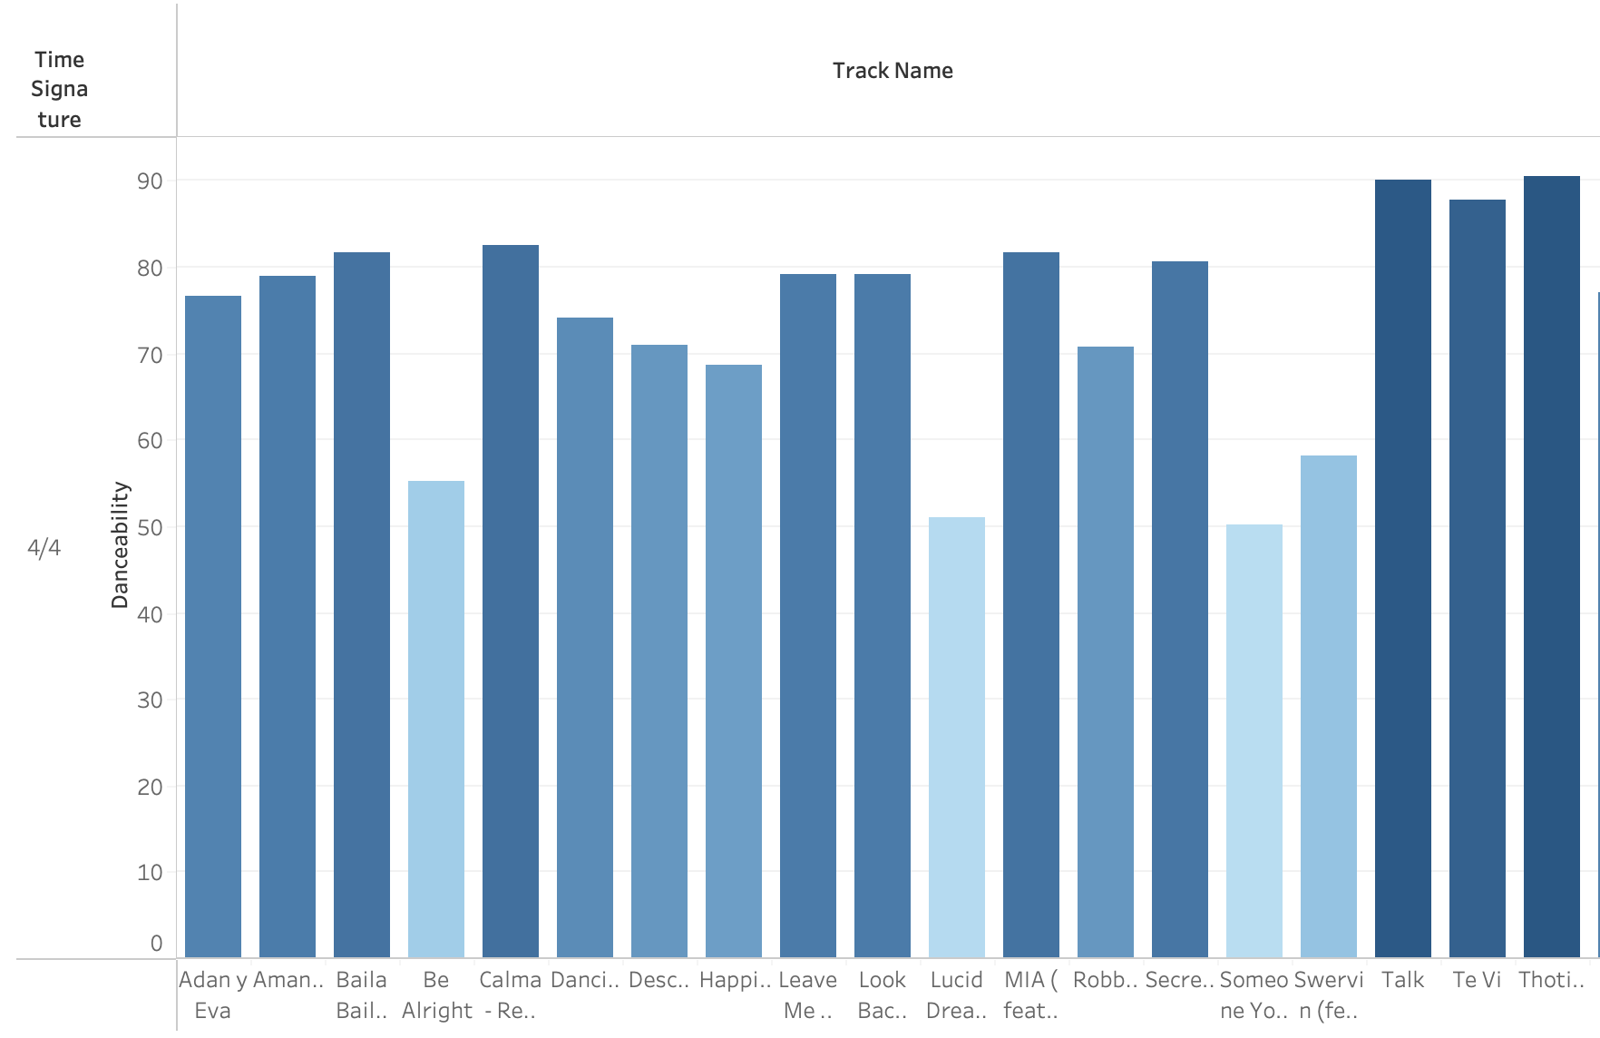

Q3 cont.
Upon further inspection into the top 20 popular songs in the dataset, we can see danceability isn’t as effective as I assumed. Even so, the one common trait amongst each top song is a 4/4 time signature proving that rhythm of a song plays a large role in listener popularity.

Slide 14
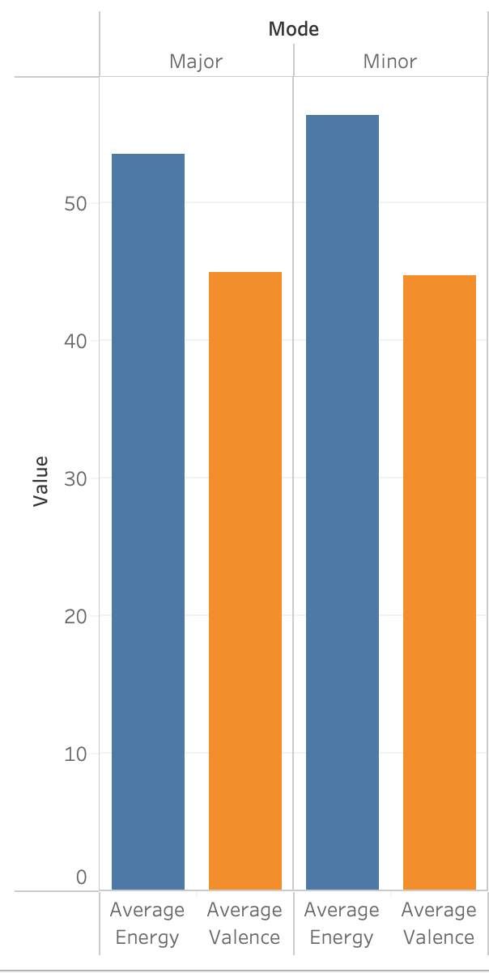
Q4) Valence/Energy and Popularity
Valence, the measure of mood such as happiness, in a song is consistent whether the song is in a Major Key, associated with happiness and liveliness, or a Minor Key, which is associated with downtempo and emotion. Since we can rule out Modes of the songs in relation to energy or valence, we can investigate further in terms of how they could impact popularity.

Slide 15
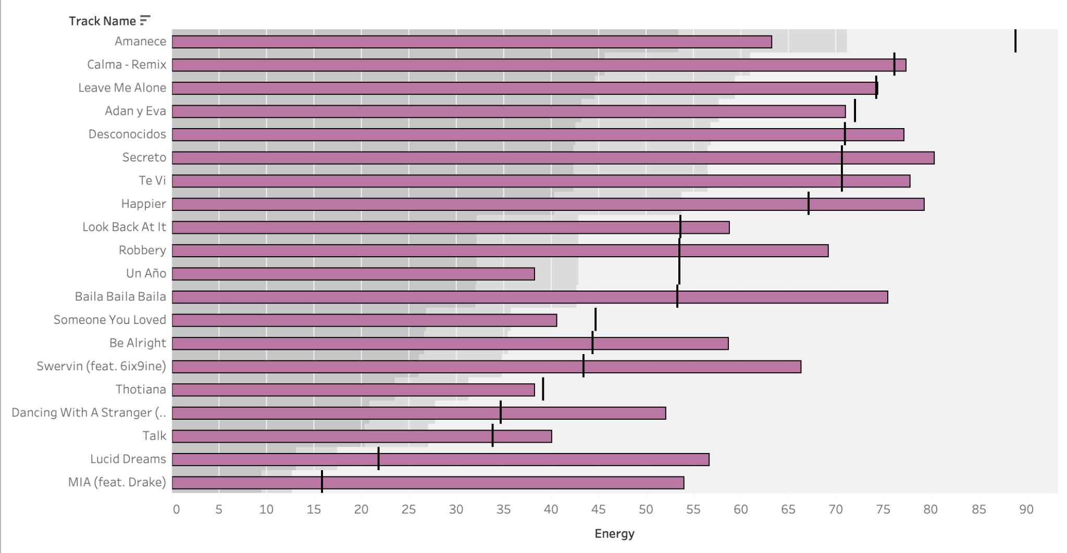
Q4 cont. Energy and Valence in Popular Songs Visualization

Slide 16
Q4 cont. Energy/Valence explanation
When inspecting the graph on the last slide, we can see a trend based upon the energy of a song. Listeners aren’t listening to music to improve their energy but as a reflection of their energy. The most popular songs aren’t too energetic but also not lacking energy entirely. Although, when comparing valence to the energy of a song in the graph we see no trend at all. The valences range anywhere from negative to positive valence, basing popularity on valence would prove to be insufficient since the widespan moods of any listener can vary greatly.

Slide 17
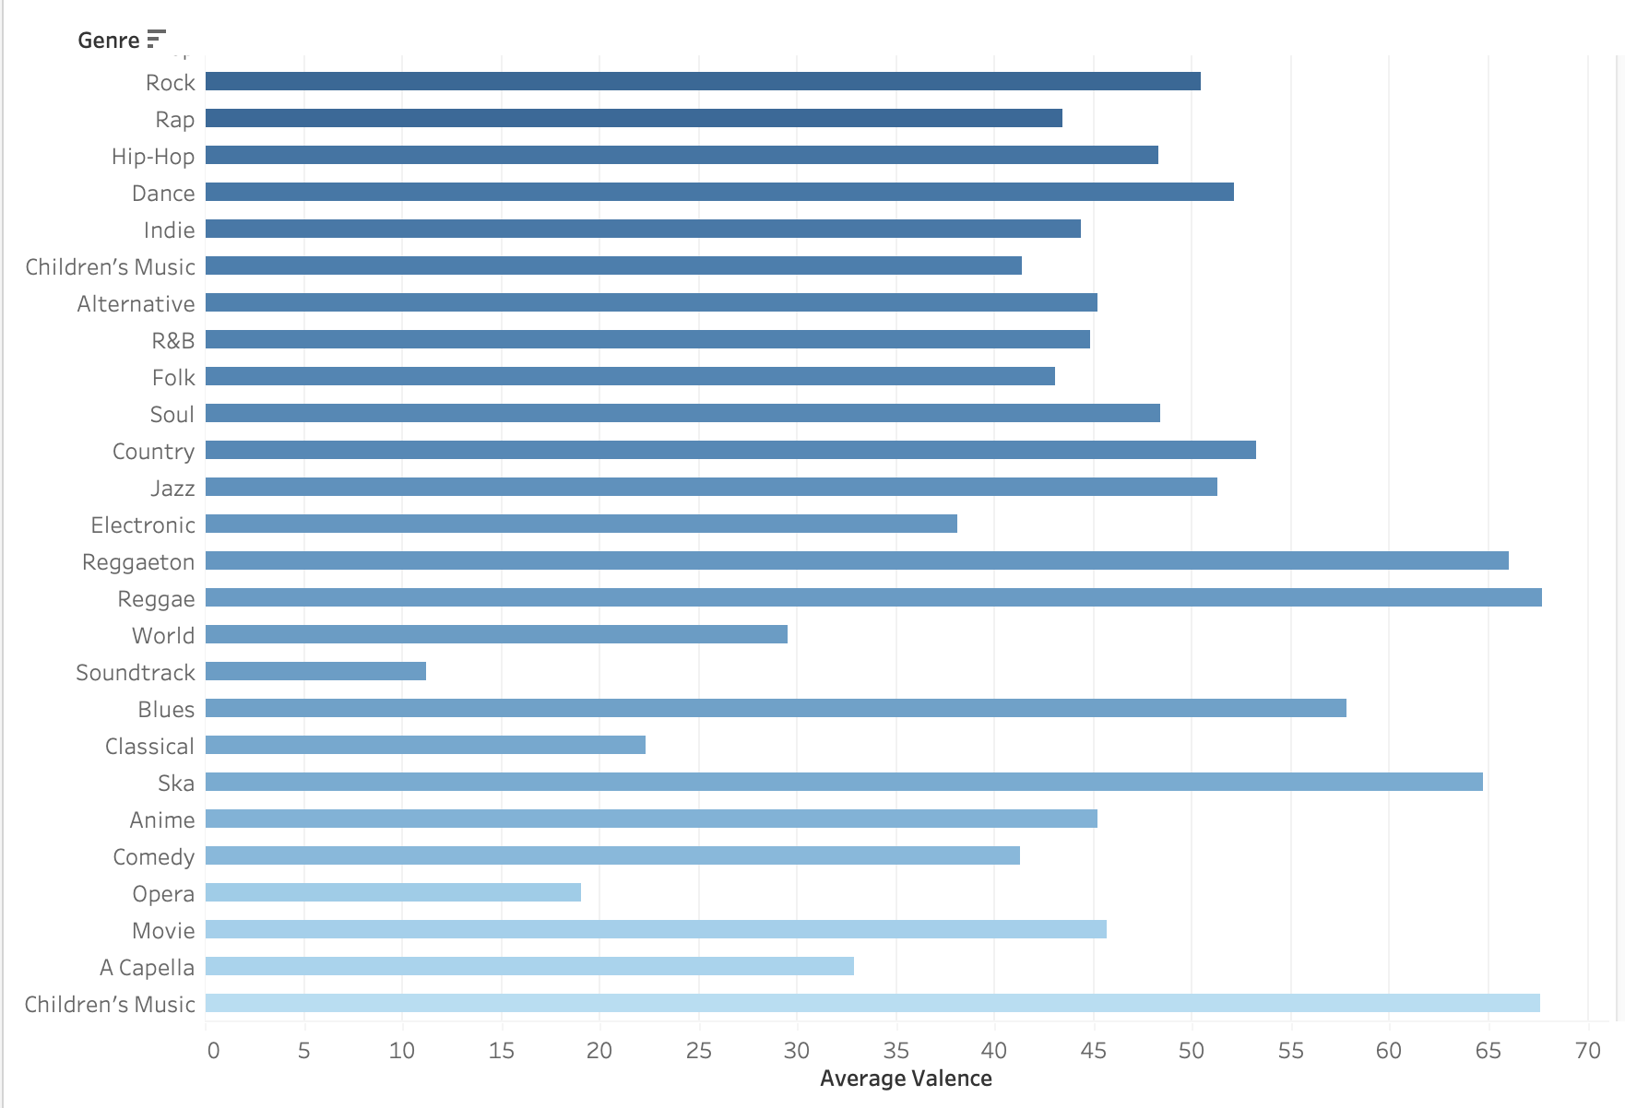
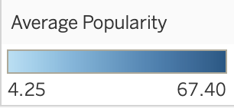
Q4 cont.
When visualizing the valence of genres, we can also confirm that the most popular genres’ valence is somewhere around the middle to have the songs not too negative sounding or positive.

Slide 18
Findings and Hypothesis
To summarize my findings after analysing the data, 3 out of my 4 hypothesis were correct. The type of music, such as genre, does play a large role in how popular a song could be. More pop and hip-hop songs are seeing more airplay and retaining popularity amongst listeners. Even so, genres such as Reggaeton and Rock still see popularity in the industry today, especially with Reggaeton seeing a surge in popularity in the modern age. These genres of music also have a great amount of danceability present in their songs, making listeners feel more engaged with the beat. My hypothesis about musical modes and theory playing a role in popularity was disproved by the data. Modern music listeners aren’t all musically inclined to have musical modes or uncommon time signatures play a part in how much the songs are being listened to.

Slide 19
Conclusion
When making music in the modern age, when wanting to cut through the noise of the large list of songs that are released daily. We can conclude genre, tempo, danceability, and even runtime play a pivotal role in how much a listener will like the song or how widely a song can reach in terms of popularity. The most popular songs have consistent rhythm, a fast paced tempo, and are in genres such as pop, hip-hop, and rock. There is a working formula for why the songs we hear on the radio are as popular as they are.

